Slide 1




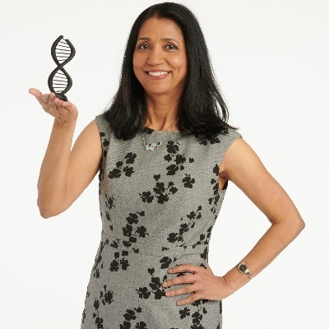

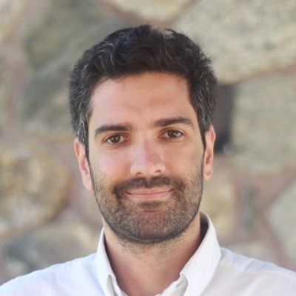
Session 1:
An overview of
quantum computing
Organizers
Aritra Bose, PhD
IBM Research
Laxmi Parida, PhD
IBM Research
Hakan Doga, PhD
IBM Quantum
Filippo Utro, PhD
IBM Research

Slide 2
Learning outcomes of Session 1
Learning about the history of quantum computing
Understanding different technologies for building quantum computers
The difference between classical computing and quantum computing
A clear understanding of the fundamental concepts in quantum computing such as qubits, quantum gates and circuits, and measurement
Distinguishing different complexity classes and where quantum can make a difference
Exploration of different application of quantum computing
Learning about the near-term and fault-tolerant quantum hardware developments
Setting up a local environment to use Qiskit 1.0
Learning the implementation of quantum gates, observables and primitives in Qiskit
Understanding the transpilation of a circuit on a real quantum backend
IBM Quantum

Slide 3
A brief history of quantum computing
Quantum computing is the field of computation where we investigate the computational power and other properties of computation based on quantum mechanics
These fundamental principles of quantum mechanics such as superposition, entanglement and interference are the main building blocks for the quantum computational theory
The main ideas that built a foundation for quantum computing can be traced back to early 20th century (Planck, Bohr, Heisenberg, Schrodinger etc.)
Starting in 1960s, there were some theoretical results, as well as earlier quantum algorithms (Simon’s, Deutsch-Jozsa, Bernstein-Vazirani)
IBM Quantum

Slide 4
A brief history of quantum computing
First usage of the word Quantum Information Theory in Bennett’s notebook
IBM – MIT Conference on the Physics of Computation, 1981
One big breakthrough was Shor’s algorithm in 1994 about prime decomposition for RSA cryptography
Since then, quantum computing has become a very impactful area at the intersection of physics, computer science, mathematics, chemistry and many other disciplines!
IBM Quantum

Slide 5
What does a quantum computer look like?
Image source: https://www.science.org/content/article/scientists-are-close-building-quantum-computer-can-beat-conventional-one
IBM Quantum

Slide 6
Superconducting qubits
IBM Quantum chip, 2021 (IBM Official)
IBM Quantum Computer, golden chandelier design
IBM Quantum

Slide 7
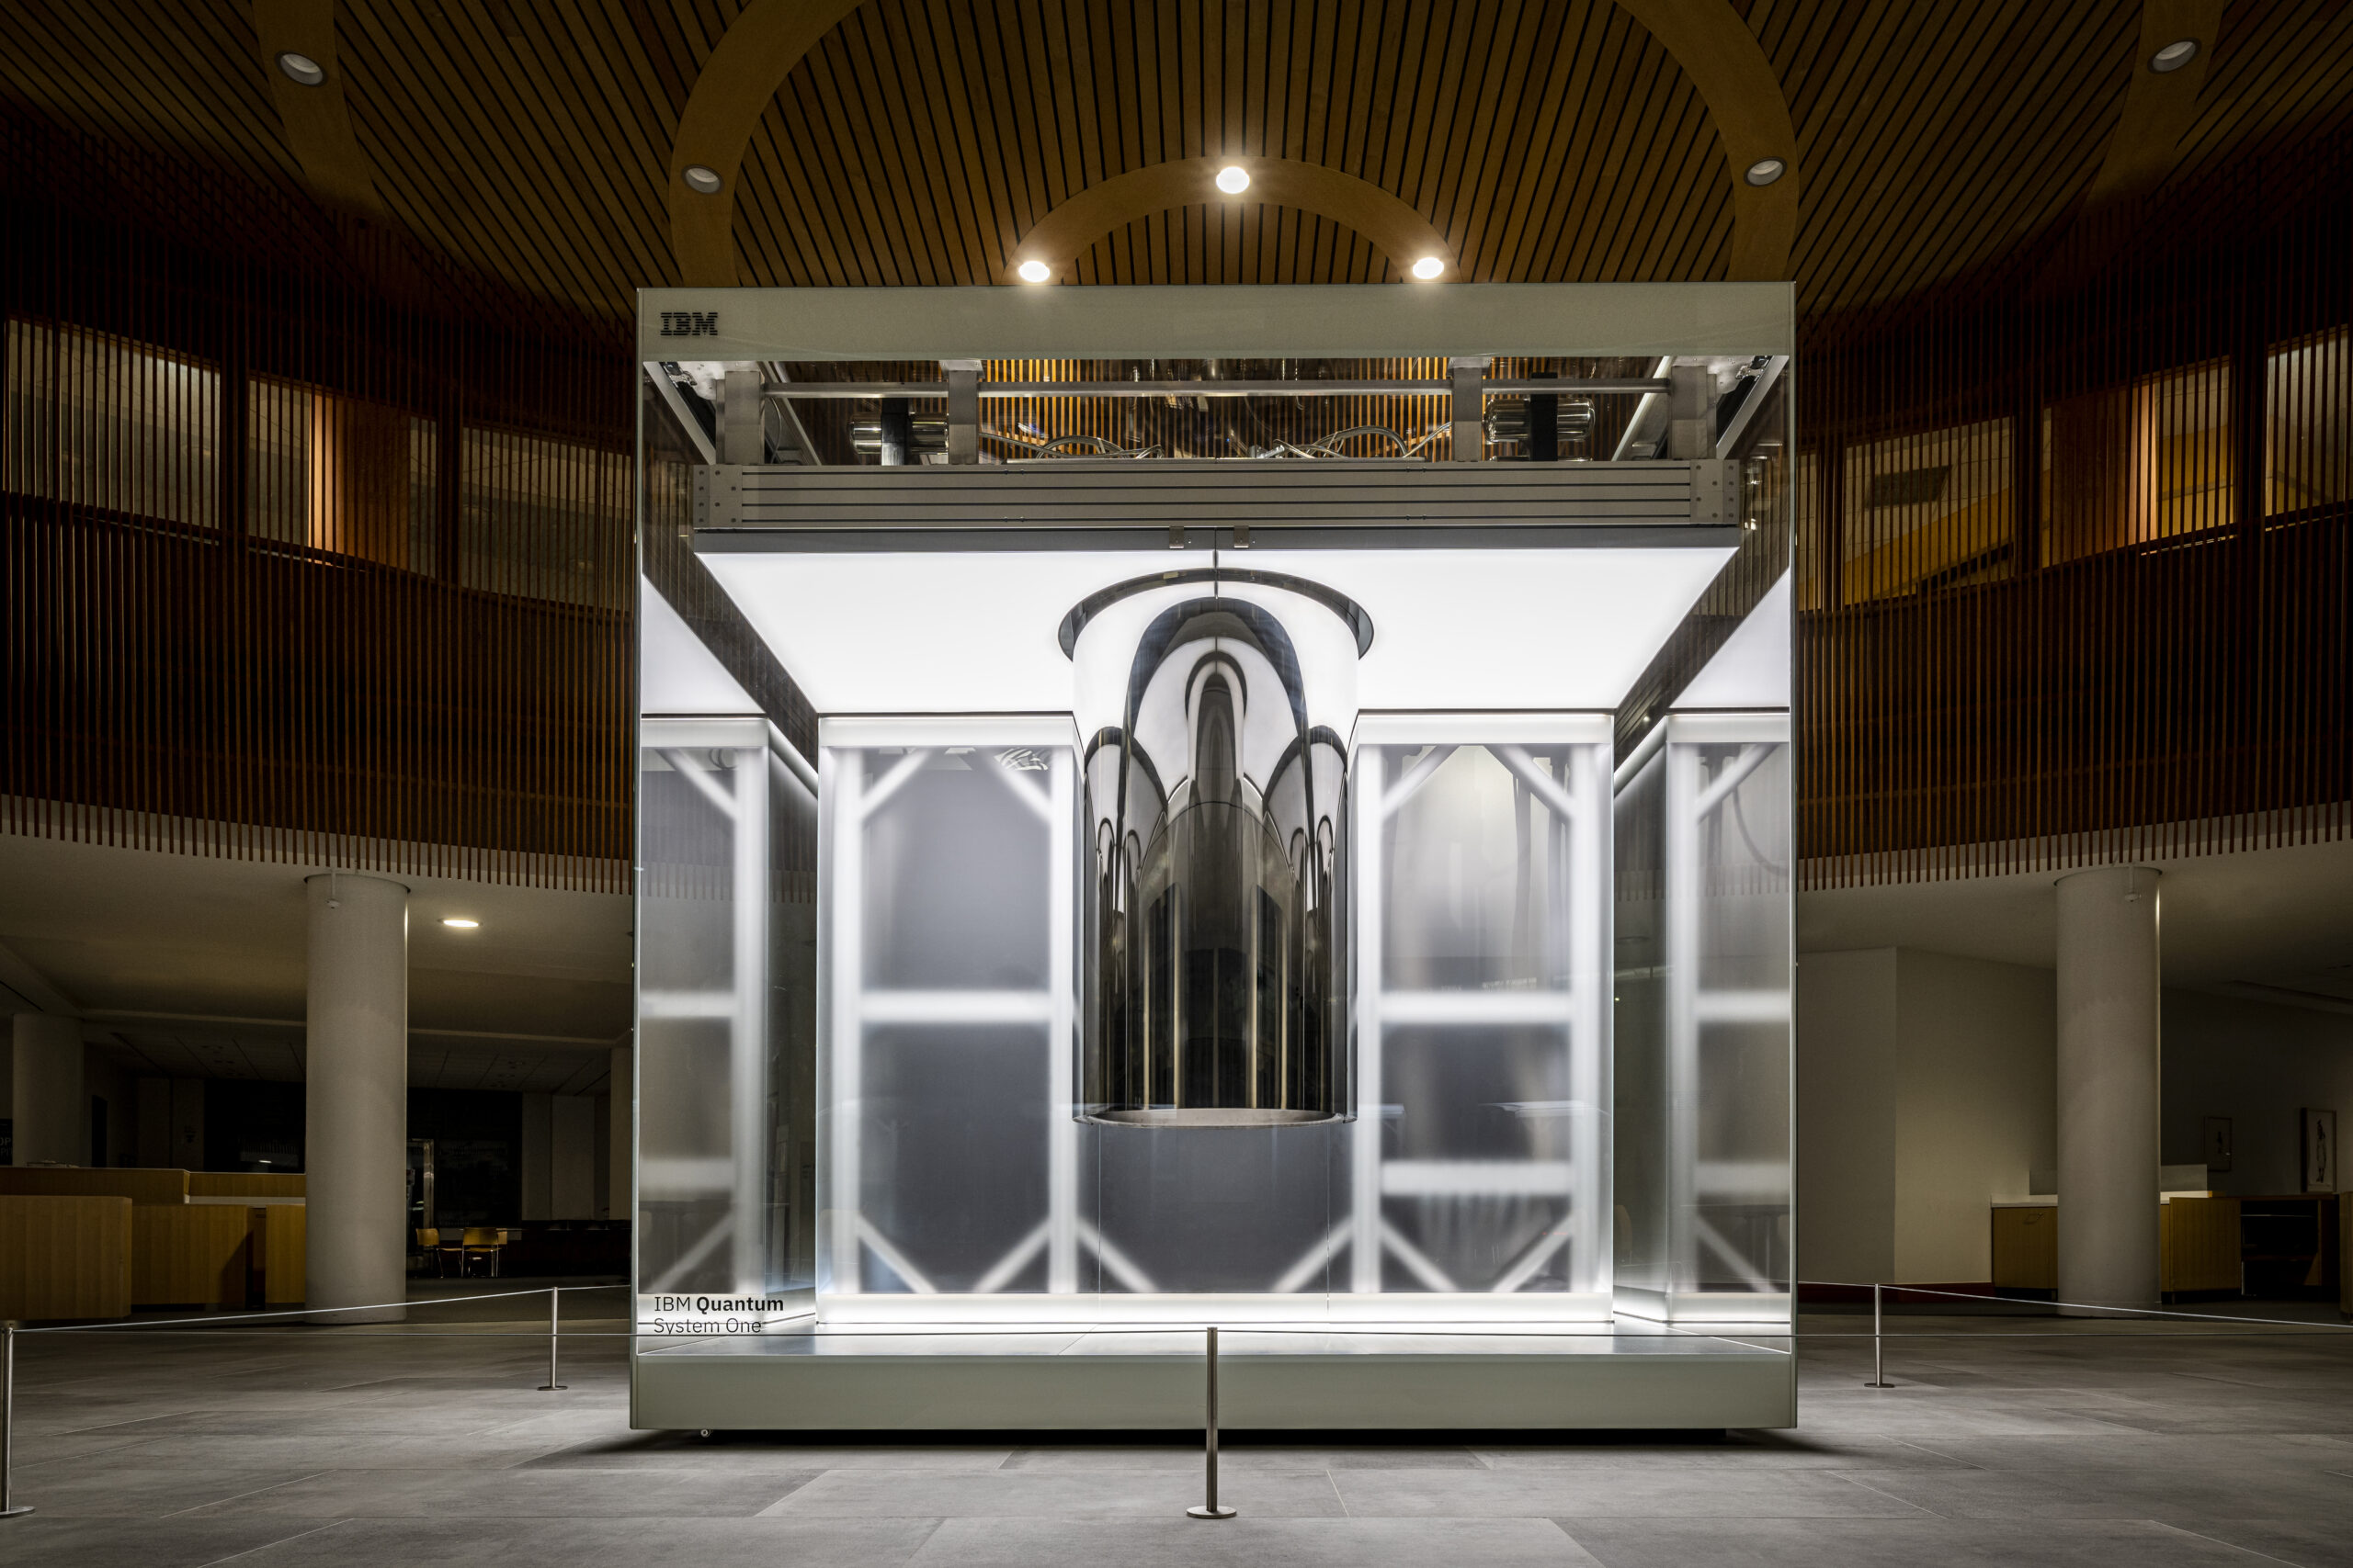
One of the largest quantum computers in the world
Image: IBM_Cleveland quantum system located at the Lerner Research Institute - Cleveland Clinic, 127 qubits
IBM Quantum

Slide 8
Classical computing
INPUT
COMPUTATION
OUTPUT
Numerical values
Vectors/matrices
Graphs
Images
Text
…
Basic arithmetic
Linear/matrix algebra
Regression
Statistical analysis
Machine learning
…
CLASSICAL
COMPUTING
Solution to the computational task
01110001 01010101 01000001 01001110 01010100 01010101 01001101
“Quantum”
01010001
01110001
01010001 01110101 01100001 01101110 01110100 01110101 01101101
“qUANTUM”
IBM Quantum

Slide 9
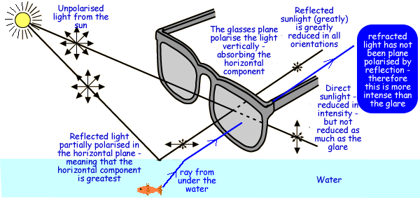
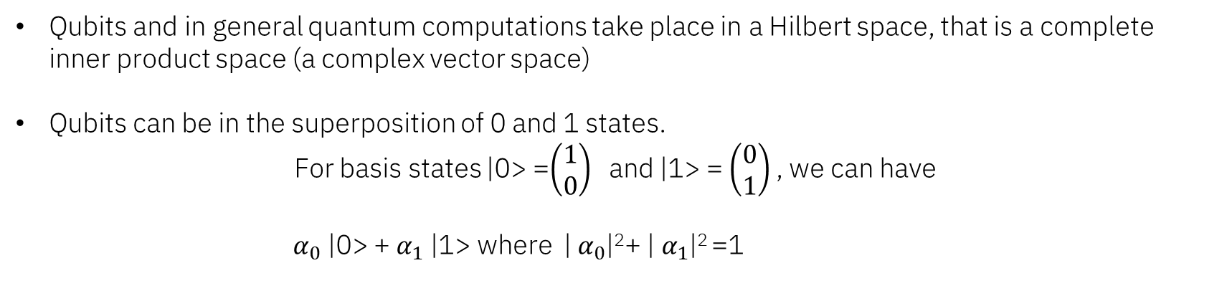
From bits to quantum bits (qubits)
Qubits and in general quantum computations take place in a Hilbert space, that is a complete inner product space (a complex vector space)
Qubits can be in the superposition of 0 and 1 states.
For basis states |0> =$\left(\begin{matrix}1 \\ 0\end{matrix}\right)$ and |1> = $\left(\begin{matrix}0 \\ 1\end{matrix}\right)$, we can have
$α_{0}$ |0> + $α_{1}$ |1> where | $α_{0}$|²+ | $α_{1}$|² =1
Polarized sunglasses is a good analogy for a quantum system where qubits are polarized photons. Say horizontal polarization is the qubit |0> and vertical polarization |1>.
Image source: https://www.cyberphysics.co.uk/topics/light/polarised_spex.htm
IBM Quantum

Slide 10
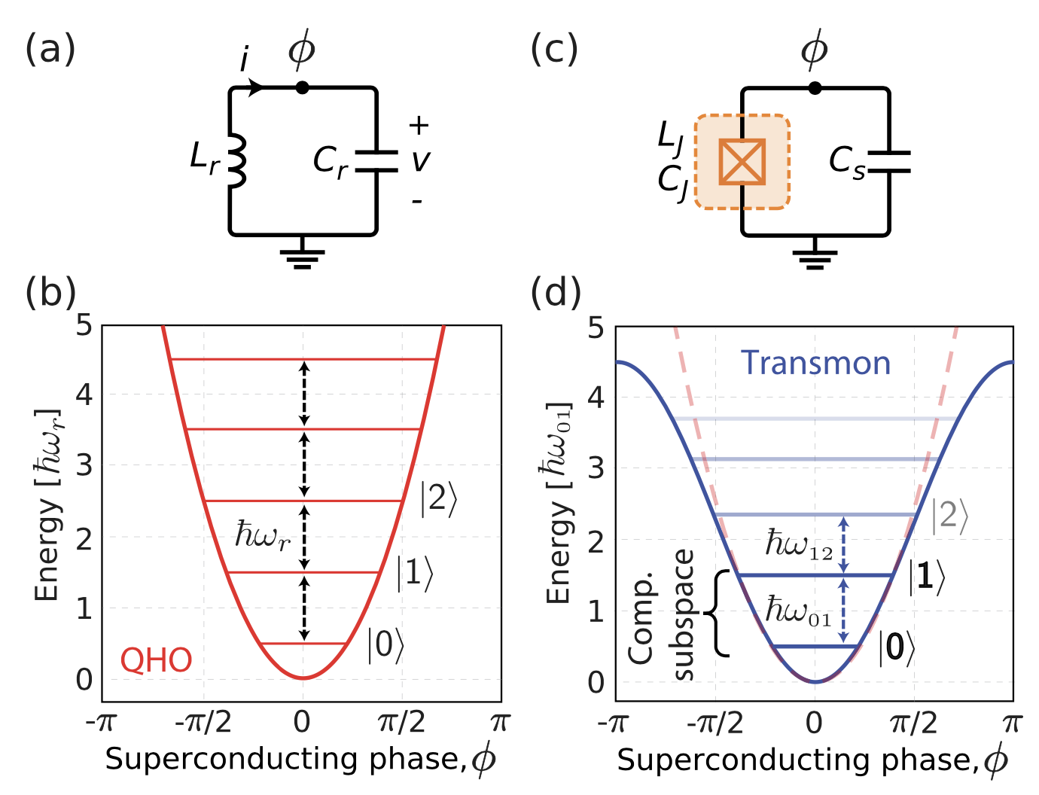
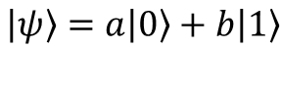
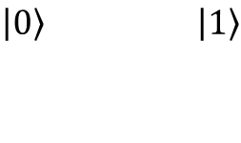
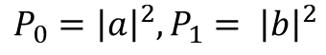
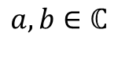
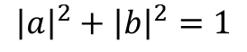
Classical
Bits
0
1
Quantum
Qubits
$$\left|0\right\rangle \left|1\right\rangle$$
$$\left|ψ\right\rangle =a\left|0\right\rangle +b\left|1\right\rangle$$
Superposition!
$$P_{0}={\left|⟨0|ψ⟩\right|}^{2}={\left|a⟨0\left|0\right\rangle +b⟨0\left|1\right\rangle \right|}^{2}={\left|a\right|}^{2}$$
$$P_{0}={\left|a\right|}^{2}, P_{1}= {\left|b\right|}^{2}$$
Source: IBM Quantum Challenge 2021
$${\left|a\right|}^{2}+{\left|b\right|}^{2}=1$$
$$a,b∈ℂ$$
IBM Quantum

Slide 11
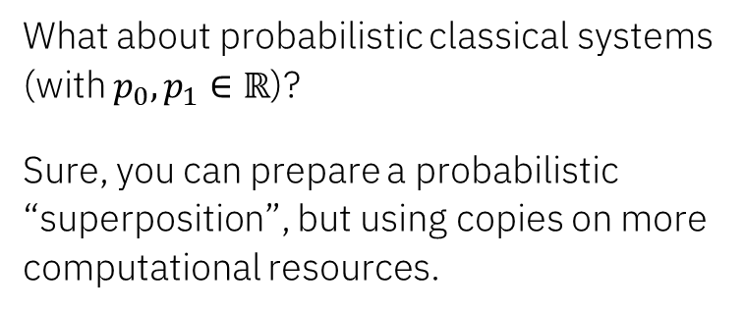
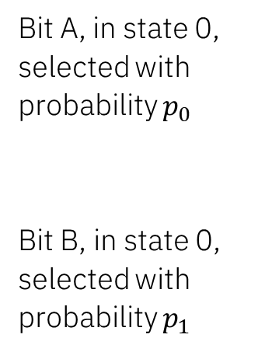
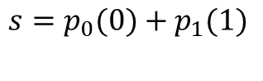
P-Classical
Superposition
Bit A, in state 0, selected with probability $p_{0}$
Bit B, in state 0, selected with probability $p_{1}$
What about probabilistic classical systems (with $p_{0},p_{1}∈ℝ$)?
Sure, you can prepare a probabilistic “superposition”, but using copies on more computational resources.
0
$$s=p_{0}(0)+p_{1}(1)$$
1
Quantum
Superposition
$$\left|0\right\rangle \left|1\right\rangle$$
$$\left|ψ\right\rangle =a\left|0\right\rangle +b\left|1\right\rangle$$
Superposition!
$$P_{0}={\left|⟨0|ψ⟩\right|}^{2}={\left|a⟨0\left|0\right\rangle +b⟨0\left|1\right\rangle \right|}^{2}={\left|a\right|}^{2}$$
$$P_{0}={\left|a\right|}^{2}, P_{1}= {\left|b\right|}^{2}$$
Source: IBM Quantum Challenge 2021
$${\left|a\right|}^{2}+{\left|b\right|}^{2}=1$$
$$a,b∈ℂ$$
IBM Quantum

Slide 12
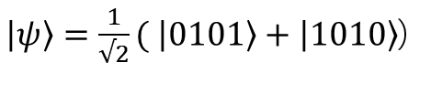
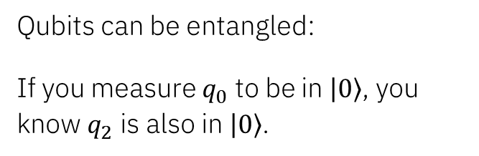
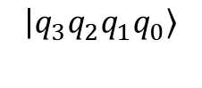
Classical
Entangled bits
Measuring bit 0 has no “effect” on bit 2
Bits 0 1 2 3
States
0
1
0
1
Quantum
Entangled qubits
Qubits can be entangled:
If you measure $q_{0}$ to be in $\left|0\right\rangle$, you know $q_{2}$ is also in $\left|0\right\rangle$.
$\left|ψ\right\rangle =\frac{1}{√2}( \left|0101\right\rangle +\left|1010\right\rangle$)
Here, we use “littlendian” ordering:
$$\left|q_{3}q_{2}q_{1}q_{0}\right\rangle$$
IBM Quantum

Slide 13
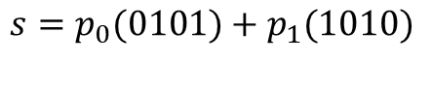
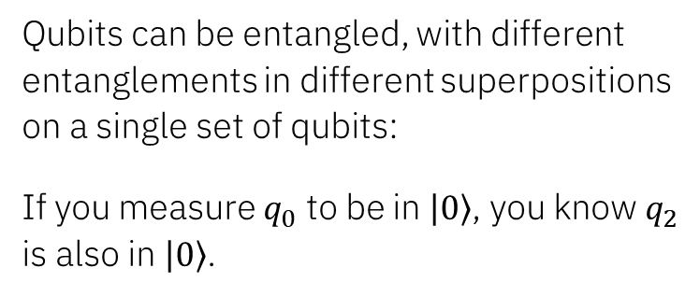
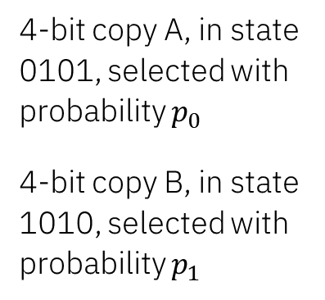
Classical
Entanglement
4-bit copy A, in state 0101, selected with probability $p_{0}$
4-bit copy B, in state 1010, selected with probability $p_{1}$
Correlations exist in classical systems. You can prepare a state like this classically, but
Using a copy of resources
Measurement of bit 0 doesn’t affect bit 2, it reveals which copy you have
$$s=p_{0}(0101)+p_{1}(1010)$$
Quantum
Entanglement
Qubits can be entangled, with different entanglements in different superpositions on a single set of qubits:
If you measure $q_{0}$ to be in $\left|0\right\rangle$, you know $q_{2}$ is also in $\left|0\right\rangle$.
$\left|ψ\right\rangle =\frac{1}{√2}( \left|0101\right\rangle +\left|1010\right\rangle$)
Here, we use “littlendian” ordering:
$$\left|q_{3}q_{2}q_{1}q_{0}\right\rangle$$
IBM Quantum

Slide 14
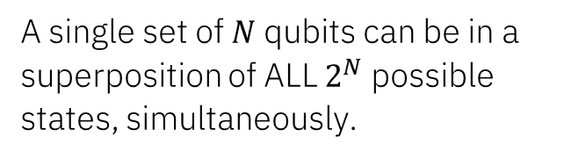
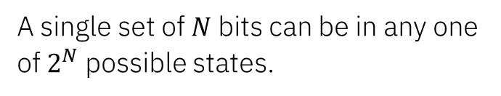
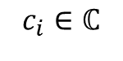
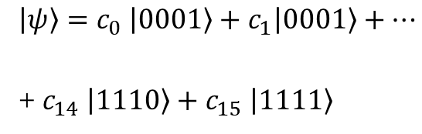
Classical
Bits
A single set of $N$ bits can be in any one of $2^{N}$ possible states.
N = 4 possible states
(0000), (0001), (0010), (0011)…
…(1100), (1101), (1110), (1111)
Quantum
Qubits
A single set of $N$qubits can be in a superposition of ALL $2^{N}$ possible states, simultaneously.
$$\left|ψ\right\rangle =c_{0} \left|0001\right\rangle +c_{1}\left|0001\right\rangle +…$$
+ $c_{14} \left|1110\right\rangle +c_{15} \left|1111\right\rangle$
$$c_{i}∈ℂ$$
IBM Quantum

Slide 15
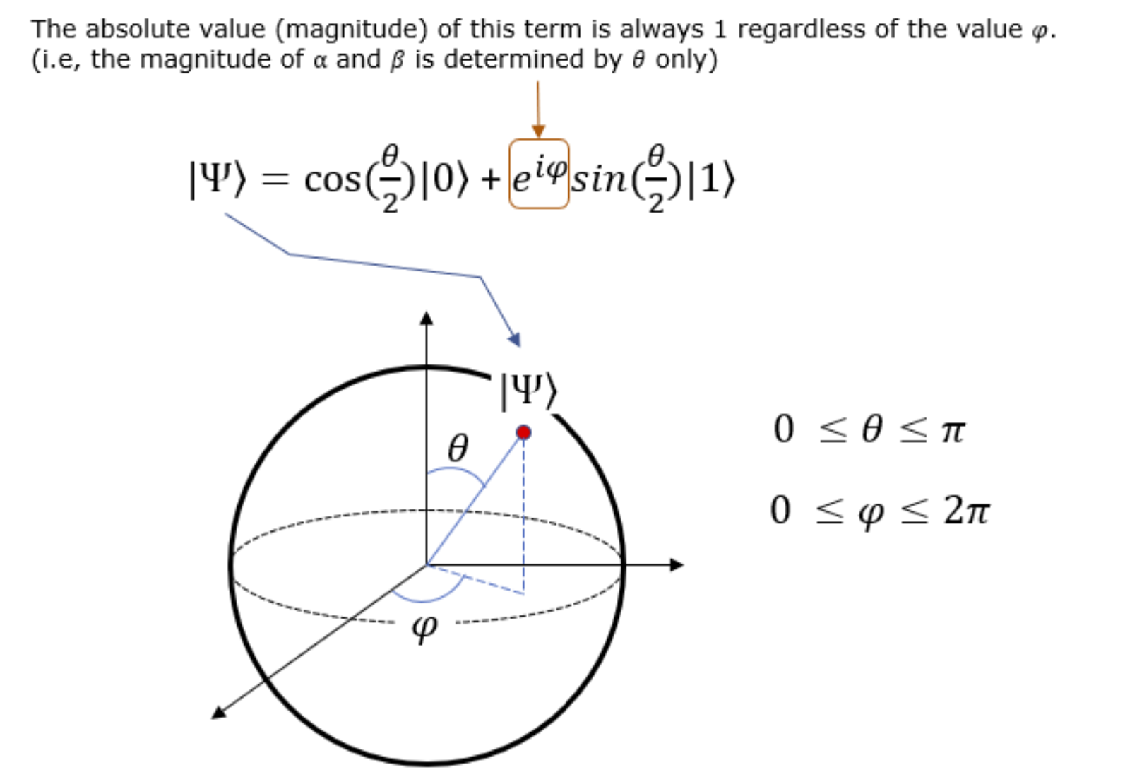
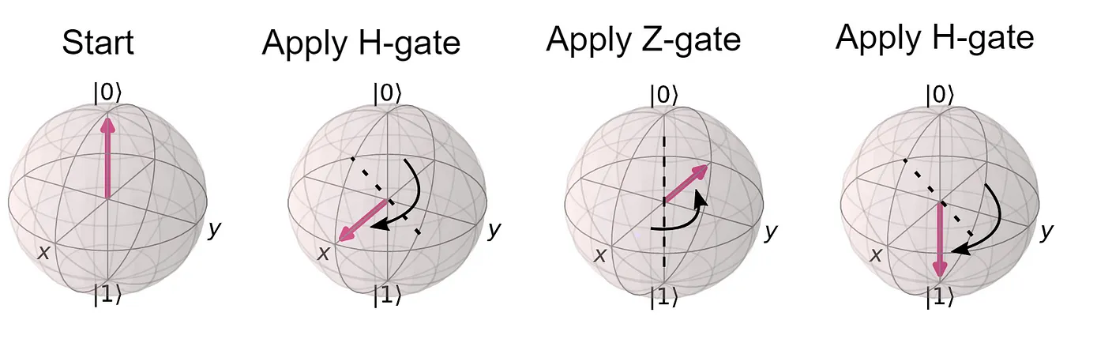
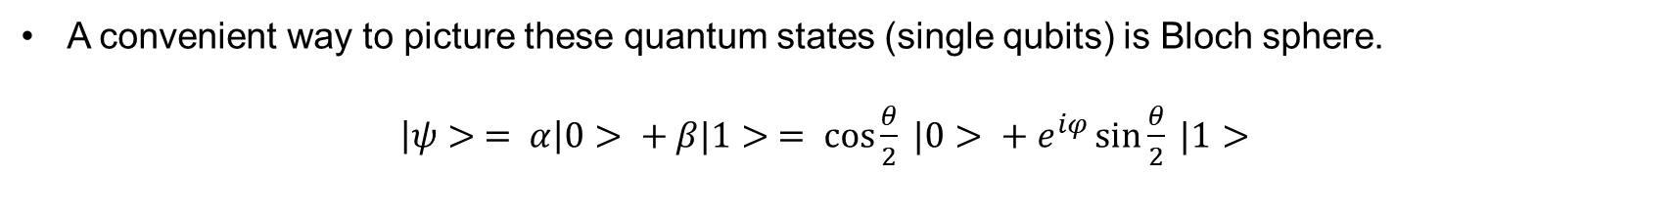
Visual representation of qubits
A convenient way to picture these quantum states (single qubits) is Bloch sphere.
$\left|ψ> = α\right|0> + β|1> = \cos{\frac{θ}{2}} |0> + e^{iφ}\sin{\frac{θ}{2}} |1>$
|+>
|->
Image source: https://www.sharetechnote.com/html/QC/QuantumComputing_BlochSphere.html
IBM Quantum

Slide 16
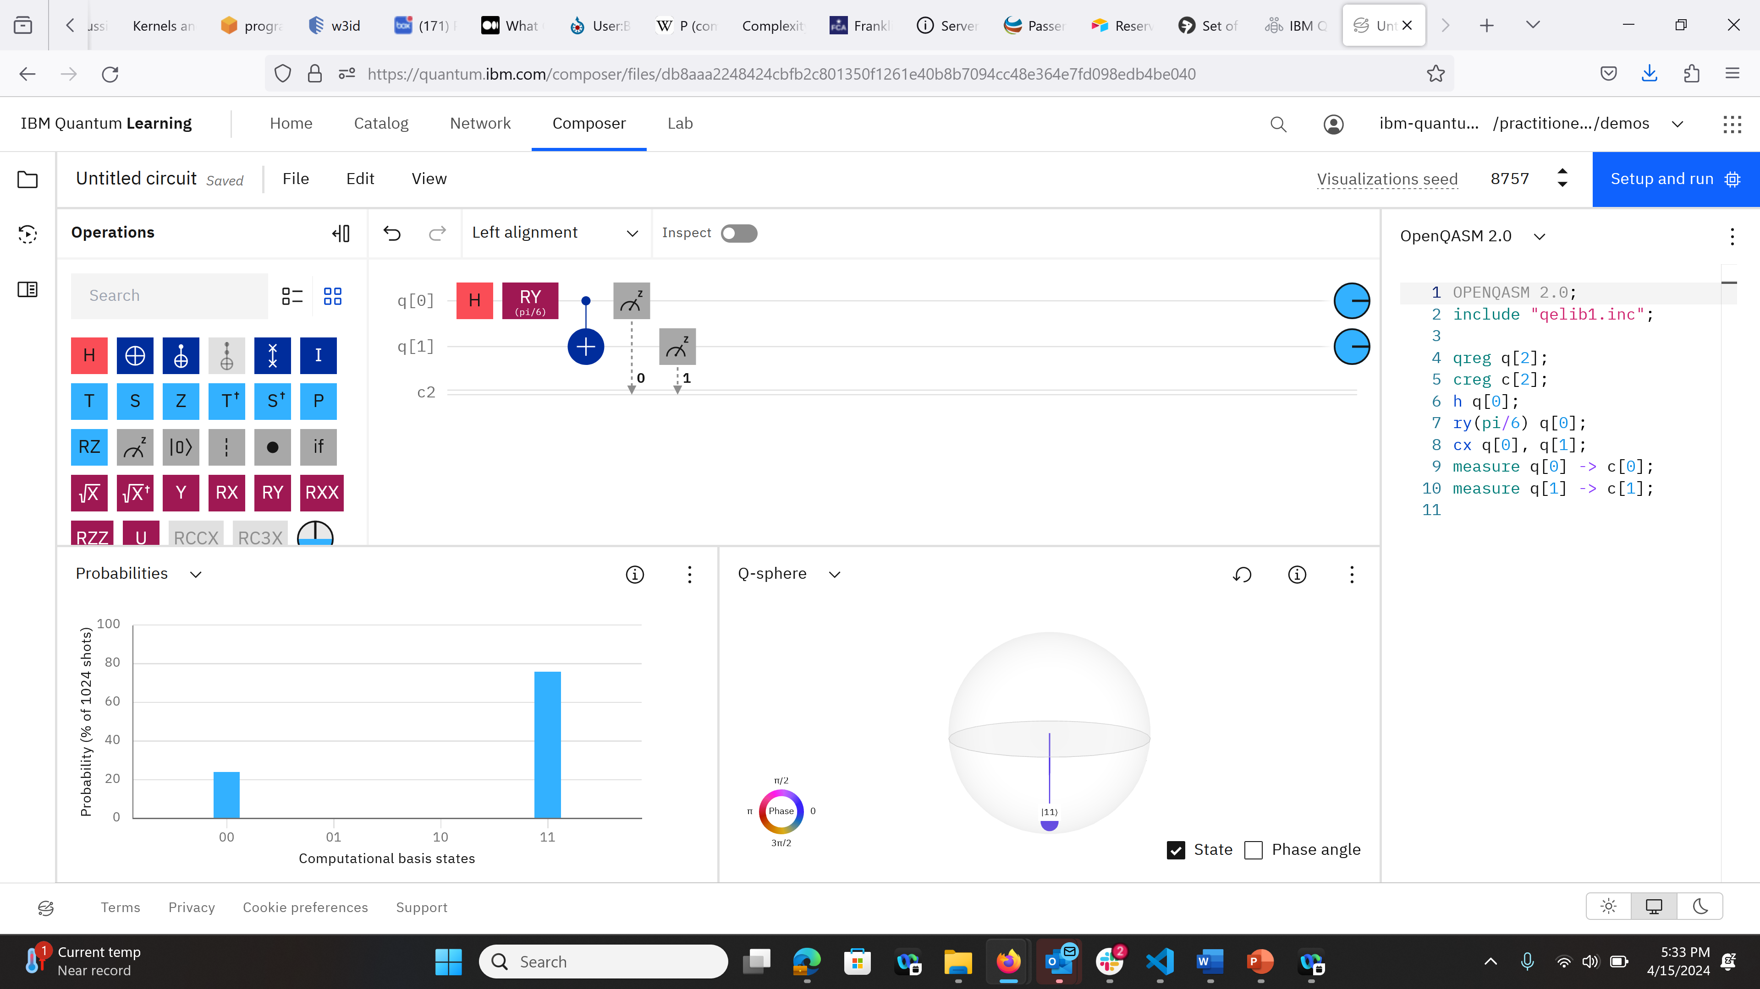
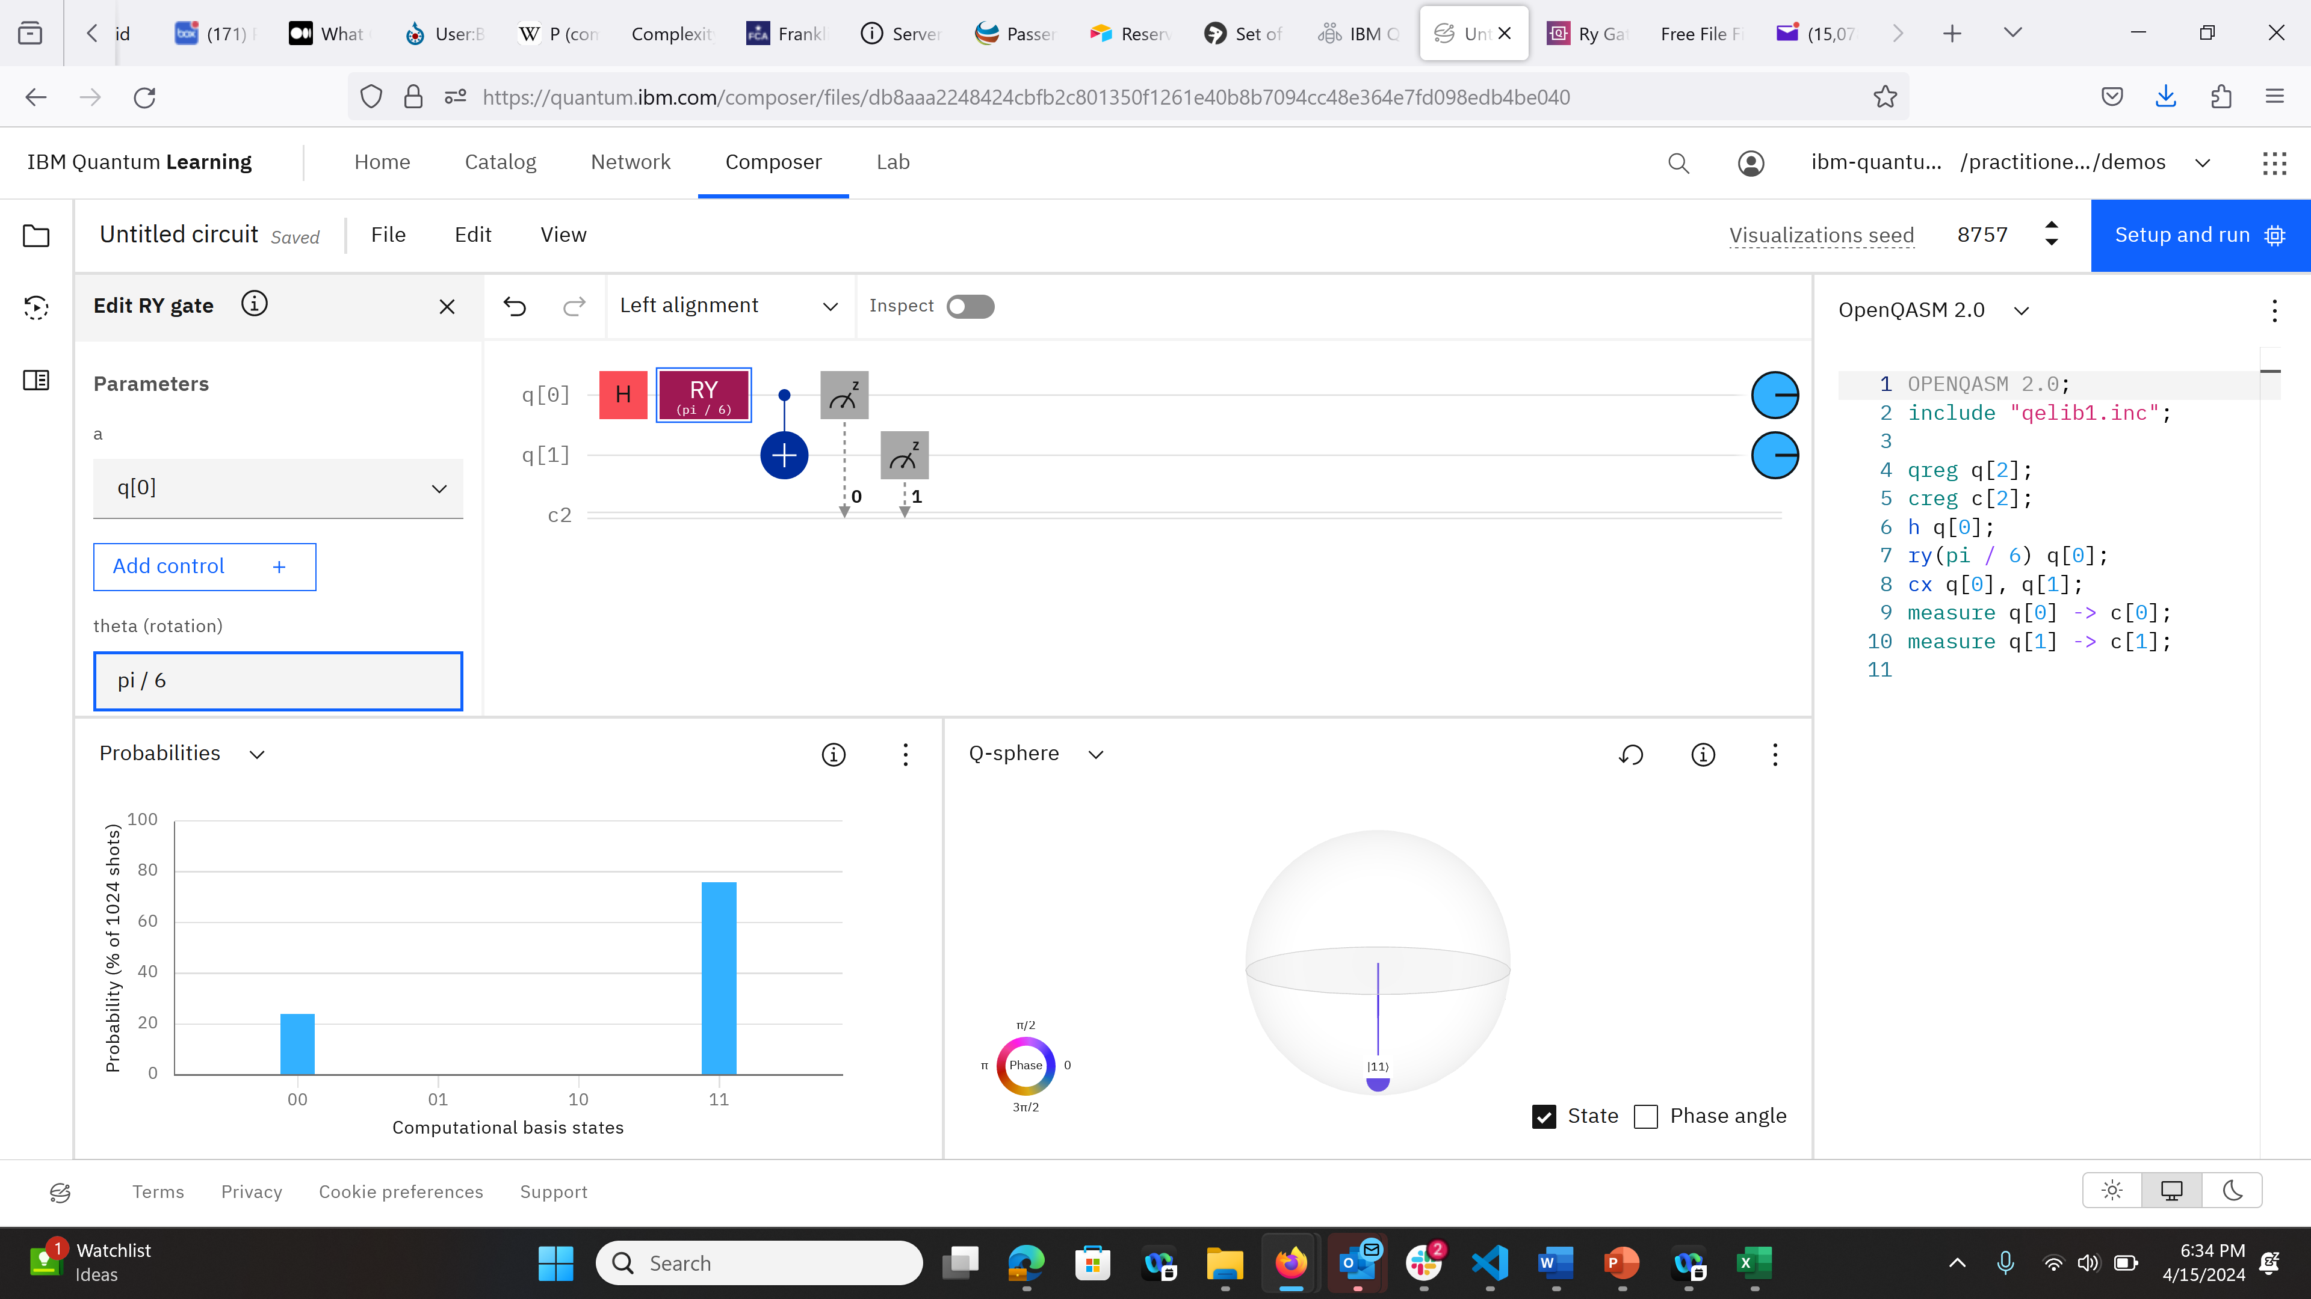
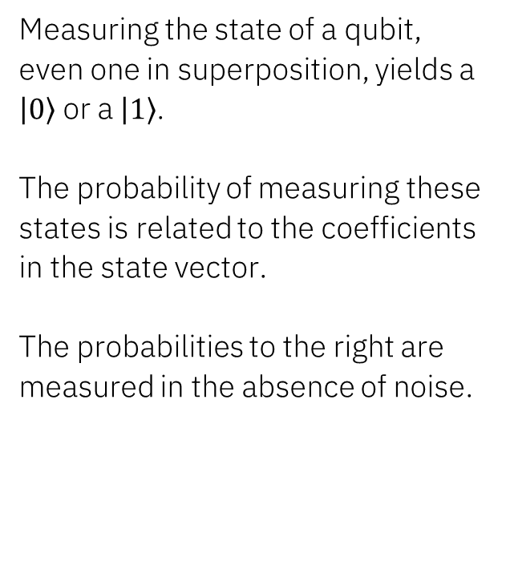
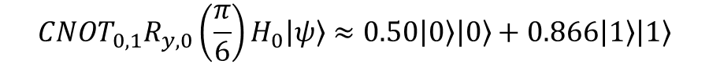
Measurement
$${{CNOT_{0,1}R}_{y,0}\left(\frac{π}{6}\right)H}_{0}\left|ψ\right\rangle ≈0.50\left|0\right\rangle \left|0\right\rangle +0.866\left|1\right\rangle \left|1\right\rangle$$
Measuring the state of a qubit, even one in superposition, yields a $\left|0\right\rangle$or a $\left|1\right\rangle$. The probability of measuring these states is related to the coefficients in the state vector.
The probabilities to the right are measured in the absence of noise.
H, above and in the diagram, is the Hadamard gate, not to be confused with the Hamiltonian.
IBM Quantum

Slide 17
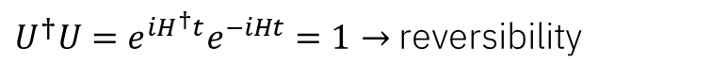
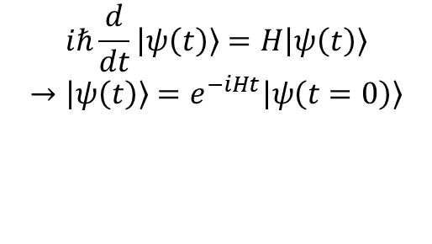
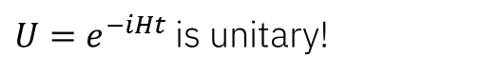
Unitaries
Time evolution in quantum is described by the Schrödinger equation.
This means unitary matrices,
which leads to unitary gates. It also gives us complex coefficients.
Schrödinger equation:
$$iℏ\frac{d}{dt}\left|ψ\left(t\right)\right\rangle =H\left|ψ\left(t\right)\right\rangle$$
$$→\left|ψ\left(t\right)\right\rangle =e^{−iHt}\left|ψ\left(t=0\right)\right\rangle$$
${U=e}^{−iHt}$ is unitary!
Unitary operators:
$U^{†}U=e^{iH^{†}t}e^{−iHt}=1→$ reversibility
H is the Hamiltonian, the operator describing the energy of the system, different from case to case, not to be confused with the Hadamard gate.
IBM Quantum

Slide 18
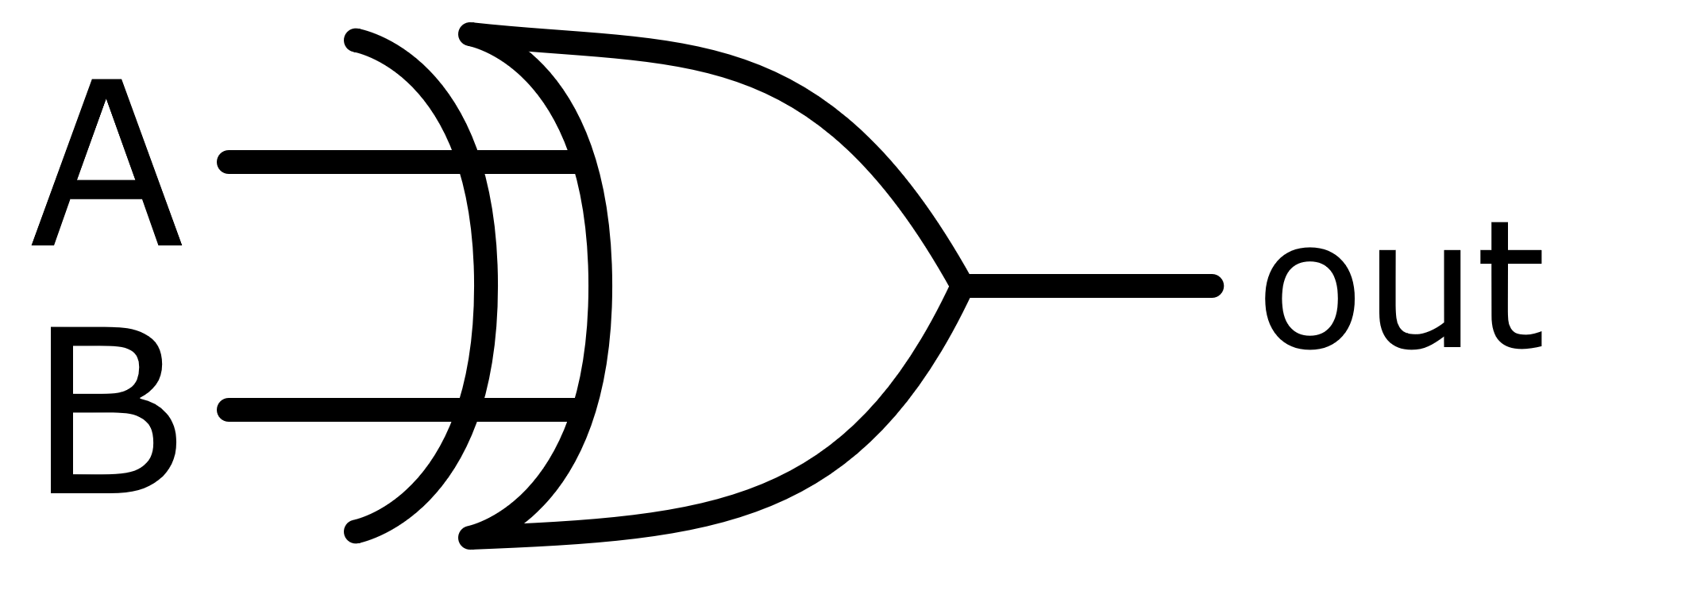
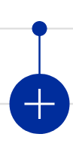
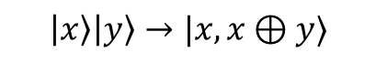
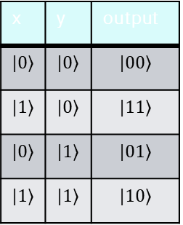
Classical
Gates
XOR¹
A | B | A XOR B
0 | 0 | 0
1 | 0 | 1
0 | 1 | 1
1 | 1 | 0
Classical gates may or may not be unitary
¹Source: Wikipedia Commons
Quantum
Unitary Gates
Quantum gates are unitary.
CNOT
x | y | output
$$|0⟩$$ | $$|0⟩$$ | $$|00⟩$$
$$|1⟩$$ | $$|0⟩$$ | $$|11⟩$$
$$|0⟩$$ | $$|1⟩$$ | $$|01⟩$$
$$|1⟩$$ | $$|1⟩$$ | $$|10⟩$$
$$\left|x\right\rangle \left|y\right\rangle →|x,x⊕y⟩$$
Reversible!
IBM Quantum

Slide 19
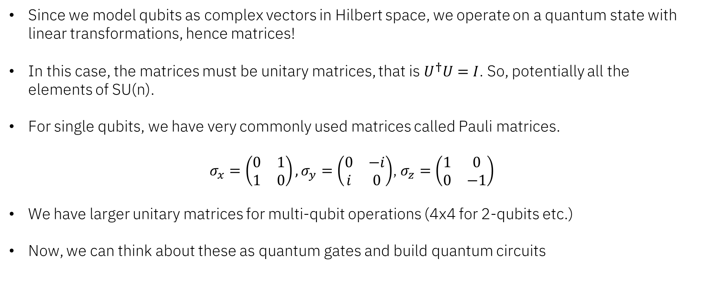
Operating on qubits
Since we model qubits as complex vectors in Hilbert space, we operate on a quantum state with linear transformations, hence matrices!
In this case, the matrices must be unitary matrices, that is $U^{†}U=I$. So, potentially all the elements of SU(n).
For single qubits, we have very commonly used matrices called Pauli matrices.
$σ_{x}=\left(\begin{matrix}0 & 1 \\ 1 & 0\end{matrix}\right),σ_{y}=\left(\begin{matrix}0 & −i \\ i & 0\end{matrix}\right)$, $σ_{z}=\left(\begin{matrix}1 & 0 \\ 0 & −1\end{matrix}\right)$
We have larger unitary matrices for multi-qubit operations (4x4 for 2-qubits etc.)
Now, we can think about these as quantum gates and build quantum circuits
IBM Quantum

Slide 20
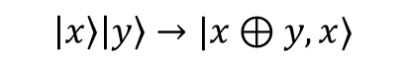
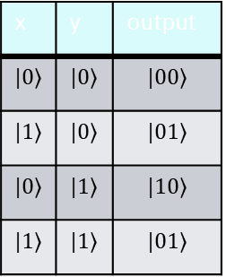
Classical
Gates
XOR¹
A | B | A XOR B
0 | 0 | 0
1 | 0 | 1
0 | 1 | 1
1 | 1 | 0
Classical gates may or may not be unitary
¹Source: Wikipedia Commons
Quantum
Unitary Gates
Quantum gates are unitary.
CNOT
x | y | output
$$|0⟩$$ | $$|0⟩$$ | $$|00⟩$$
$$|1⟩$$ | $$|0⟩$$ | $$|01⟩$$
$$|0⟩$$ | $$|1⟩$$ | $$|10⟩$$
$$|1⟩$$ | $$|1⟩$$ | $$|01⟩$$
$$\left|x\right\rangle \left|y\right\rangle →|x⊕y,x⟩$$
Reversible!
IBM Quantum

Slide 21
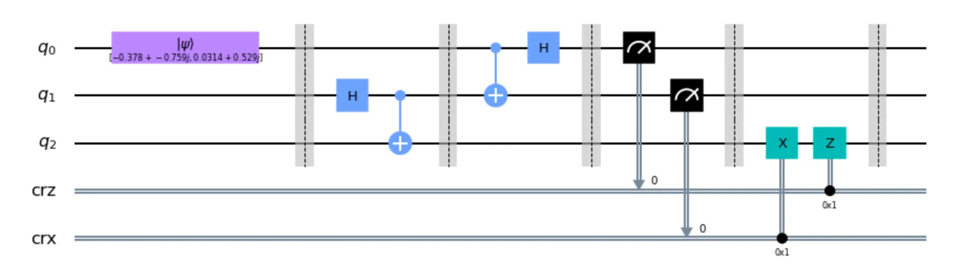
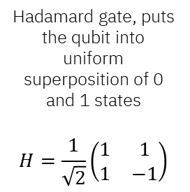
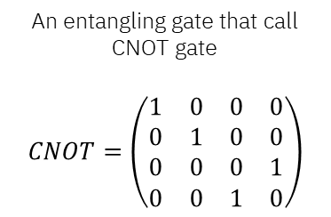
An example of quantum circuit
Qubits initialized at 0 state
Classical bits for measurement
Hadamard gate, puts the qubit into uniform superposition of 0 and 1 states
$$H=\frac{1}{\sqrt{2}}\left(\begin{matrix}1 & 1 \\ 1 & −1\end{matrix}\right)$$
An entangling gate that call CNOT gate
$$CNOT=\left(\begin{matrix}1 & 0 & 0 & 0 \\ 0 & 1 & 0 & 0 \\ 0 & 0 & 0 & 1 \\ 0 & 0 & 1 & 0\end{matrix}\right)$$
Some extra post-measurement gates that are problem specific
Measuring the qubits onto classical bits to get the state 0 or 1.
IBM Quantum

Slide 22
Foundations - differences
Quantum
Classical
Superposition _ _
Entanglement _ _
Interference
Measure a single state
Unitary gates
Complex coefficients
On or off – probabilistic “superposition” has cost
Independent system states –“entanglement” possible
No interference
Measure a single state
Unitary & non-unitary gates
Real coefficients
Are these attributes of quantum better in all cases?
No. They’re different. So where can they bring value?
IBM Quantum

Slide 23
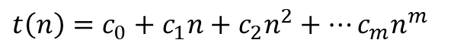
Understanding complexities
$t\left(n\right)=c_{0}+c_{1}n+c_{2}n^{2}+…c_{m}n^{m}$
P (polynomial): problems that can be solved in polynomial time.
NP – (non-deterministic polynomial): Can check a solution in polynomial time, but can’t find one in polynomial time.
NP Complete: NP-Hard problems also in NP, solutions of which map to solve all NP.
NP Hard: Problems as hard as the hardest problems in NP.
BQP (Bounded-error quantum polynomial): solvable by a quantum computer in polynomial time, with an error probability of at most 1/3
NP-Hard
NP-Complete
NP
BQP
P
Some complexity classes, under the assumption that P is not equal to NP. Note all class assignments are subject to the uncertainty of complexity class structure.
IBM Quantum

Slide 24
Understanding complexities
$t\left(n\right)=c_{0}+c_{1}n+c_{2}n^{2}+…c_{m}n^{m}$
Max-cut problem & Travelling salesperson problem
Protein folding (hydrophobic/hydrophilic, self-avoiding model)
Prime factoring
NP-Hard
NP-Complete
NP
BQP
P
Some complexity classes, under the assumption that P is not equal to NP. Note all class assignments are subject to the uncertainty of complexity class structure.
IBM Quantum

Slide 25



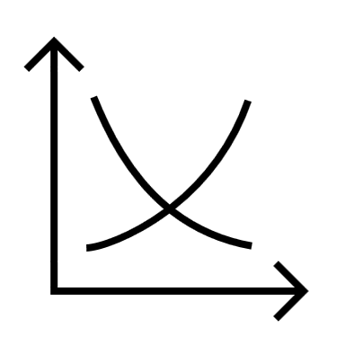






What can we do with quantum computers?
More accurate risk management methods
Improved flight/traffic scheduling
Finance/portfolio optimization
. . .
Optimization problems
Supply chain optimization
Better financial modeling
More effective therapeutics for diseases
More durable materials resisting corrosion
Chemistry simulations
More energy
efficient batteries
Better fertilizer for lower CO2 emission
. . .
Faster and more accurate
solutions!
High dimensional data analysis
Feature selection/identification
Machine learning / Cryptography
Classification/Regression tasks
. . .
RSA cryptography/prime factorization
Natural language processing
IBM Quantum

Slide 26
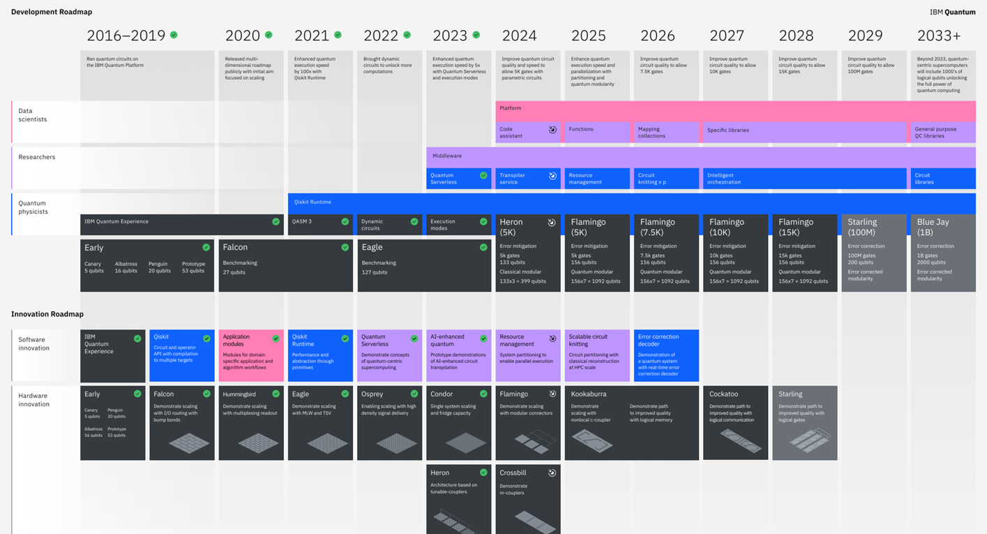
What’s next in quantum?
IBM Quantum
Image from: https://www.ibm.com/quantum/technology

Slide 27

Questions
Conclusions:
Quantum computing is different from classical computing
The differences are what make it valuable:
Superposition, entanglement
Unitary operations
Groundbreaking research is already emerging at the utility scale
IBM Quantum

Slide 28
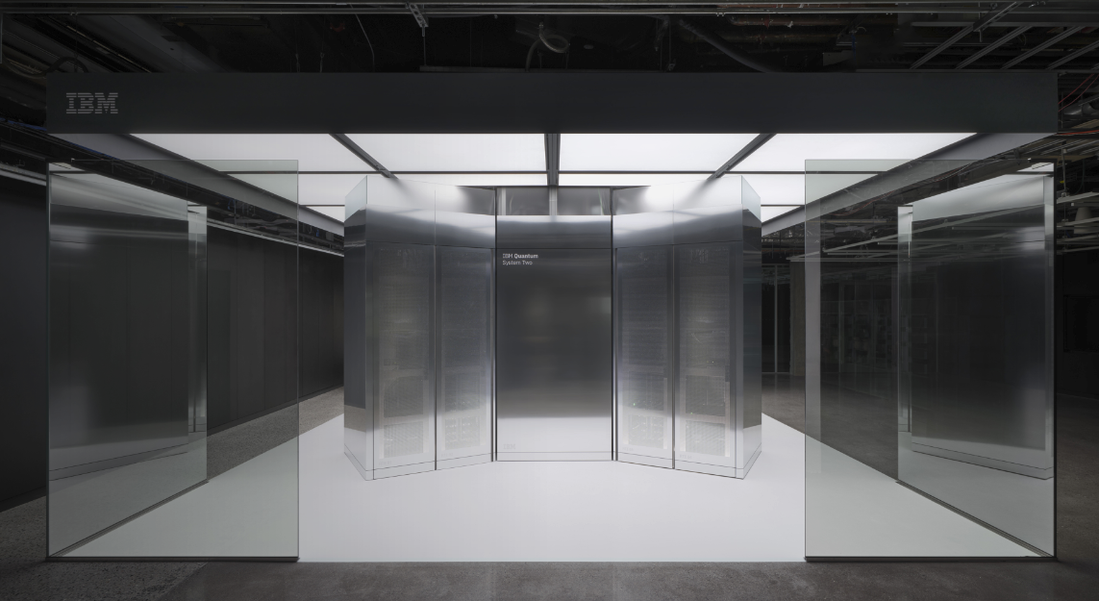
Quantum-centric supercomputing
Image from: https://www.ibm.com/quantum/technology
IBM Quantum

Slide 29
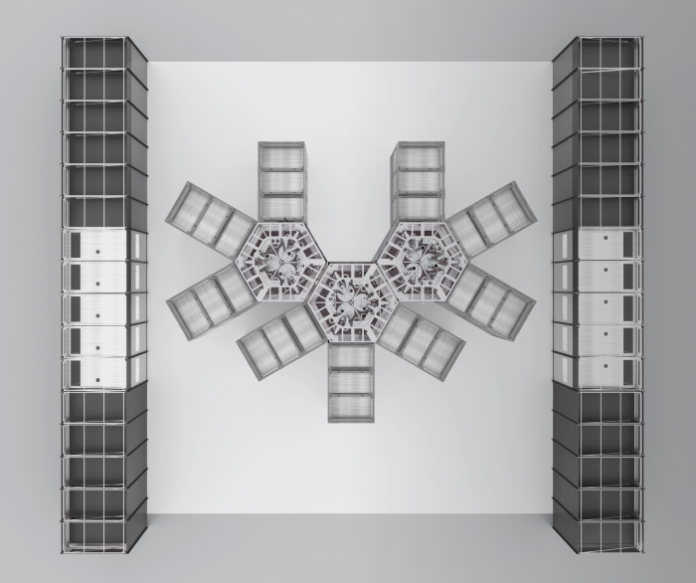
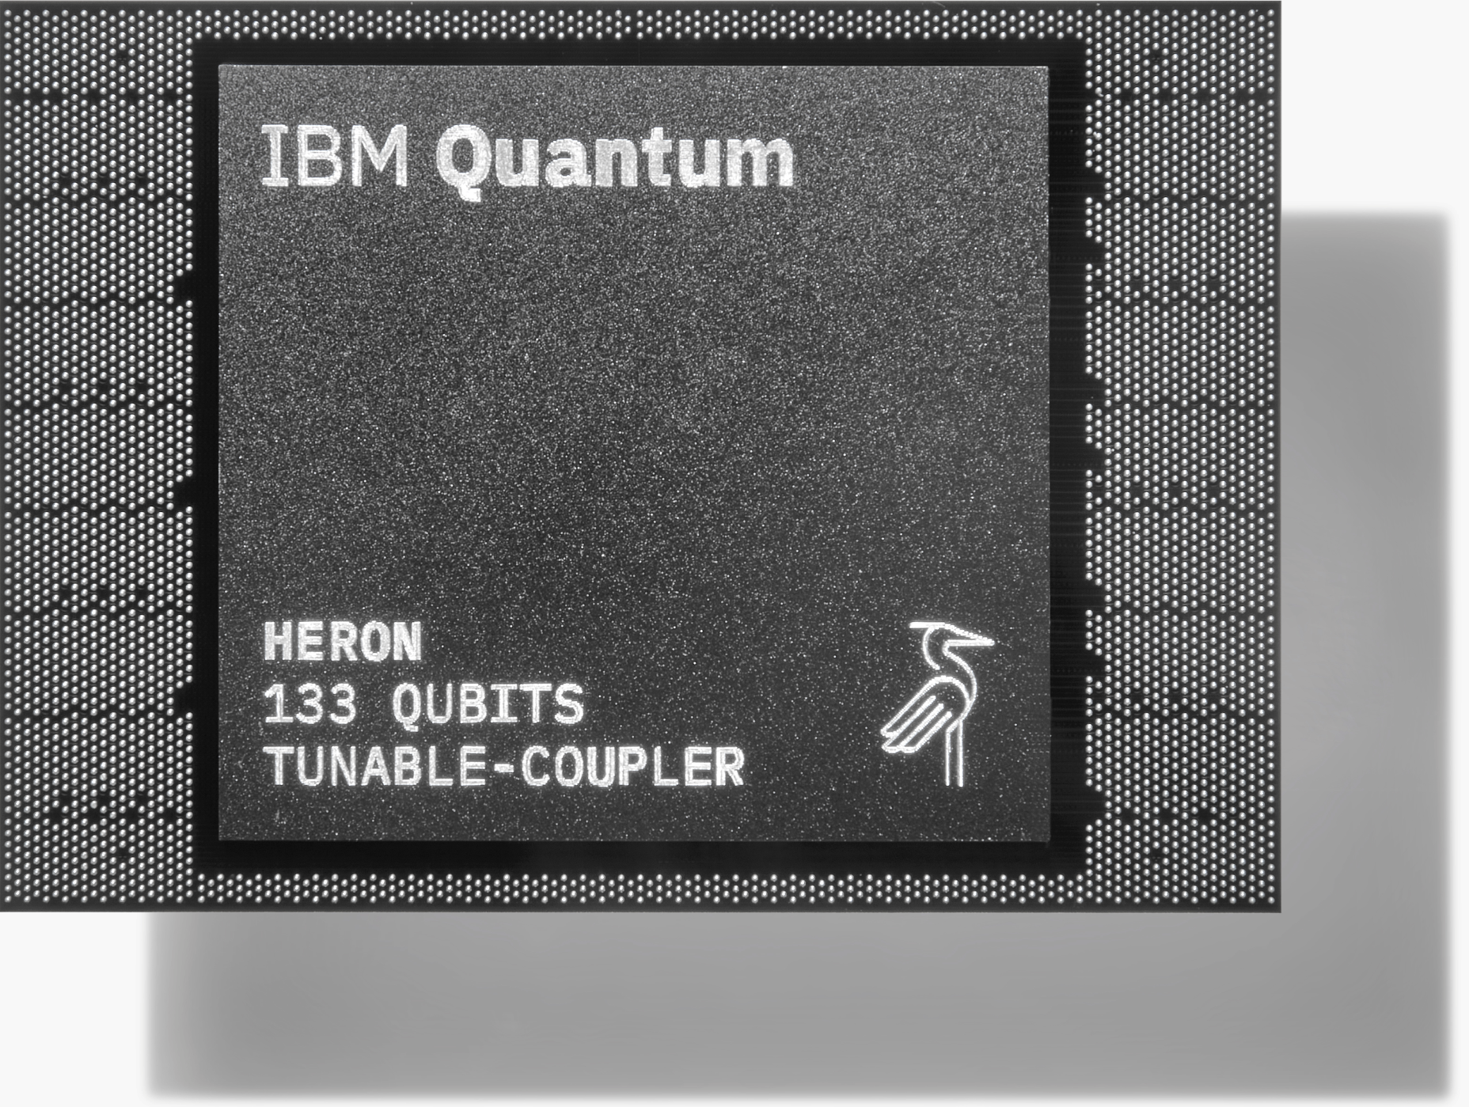
Coupling and modularity
IBM Quantum
Image from: https://www.ibm.com/quantum/technology

